Slide 1
Objective for this project
Design a trackable, self-improving system for prediction of resale HDB prices, allowing Singaporeans to estimate how much savings they need to have.
Target of ML problem
Predict resale HDB flat prices based on: time passed since 2016, location, number of rooms, house size, floor range, flat model, remaining lease
Metrics (overestimate better than under?)
Experimental: MAE
Short term: MAE
Long term: MAE within a threshold? How to define?
Retraining threshold
Based on long term goal, to be defined
Frequency of prediction
Made on request, given a selected set of variables
Online evaluation: N/A
Frequency of retraining
Every week, offline batch
Offline evaluation: Batched, MAE
Data
Baseline data: until 12 Aug, around 4-5pm
New data: Data from 13 Aug onwards. Pull from data.gov API

Slide 2
Ingestion + Feature engineering
Package for data ingestion: Polars (with SQL code)
Scheduler for ingestion: AWS EventBridge Scheduler
Feature store: AWS S3
Feature engineering: AWS Lambda (Python) → To run this every X time unit
Data versioning: MLFlow
Orchestrate using AWS EventBridge,
Mainly to deal with new data, and if retraining of model is required
Modelling > Monitoring > CI/CD
Package for modelling: scikit-learn
Package for Model/experiment versioning: MLFlow
CI/CD tool: Github Actions
A/B Testing: TBC
App (just dropdowns/radial buttons) + Deployment
Deployment: Docker(Hub) + AWS ECS + AWS Fargate
API: FastAPI
Front-end: Streamlit
Scaling (KIV): AWS App Runner + AWS ECR

Slide 3
Catch up 12 Sep 2025
Agenda:
In general: having an engineering mindset
Vetting what I’ve done
CI/CD done correctly? Robust enough? Separate vs together? Data?
What to push to cloud? E.g. AWS Lambda functions for data cleaning, MLFlow server, hyperparameter search,
When to deploy to production/main?
Usage of logging
File structure
Looking forward: Prioritising what to do next e.g. modelling
Consulting vs other types of DS

Slide 4




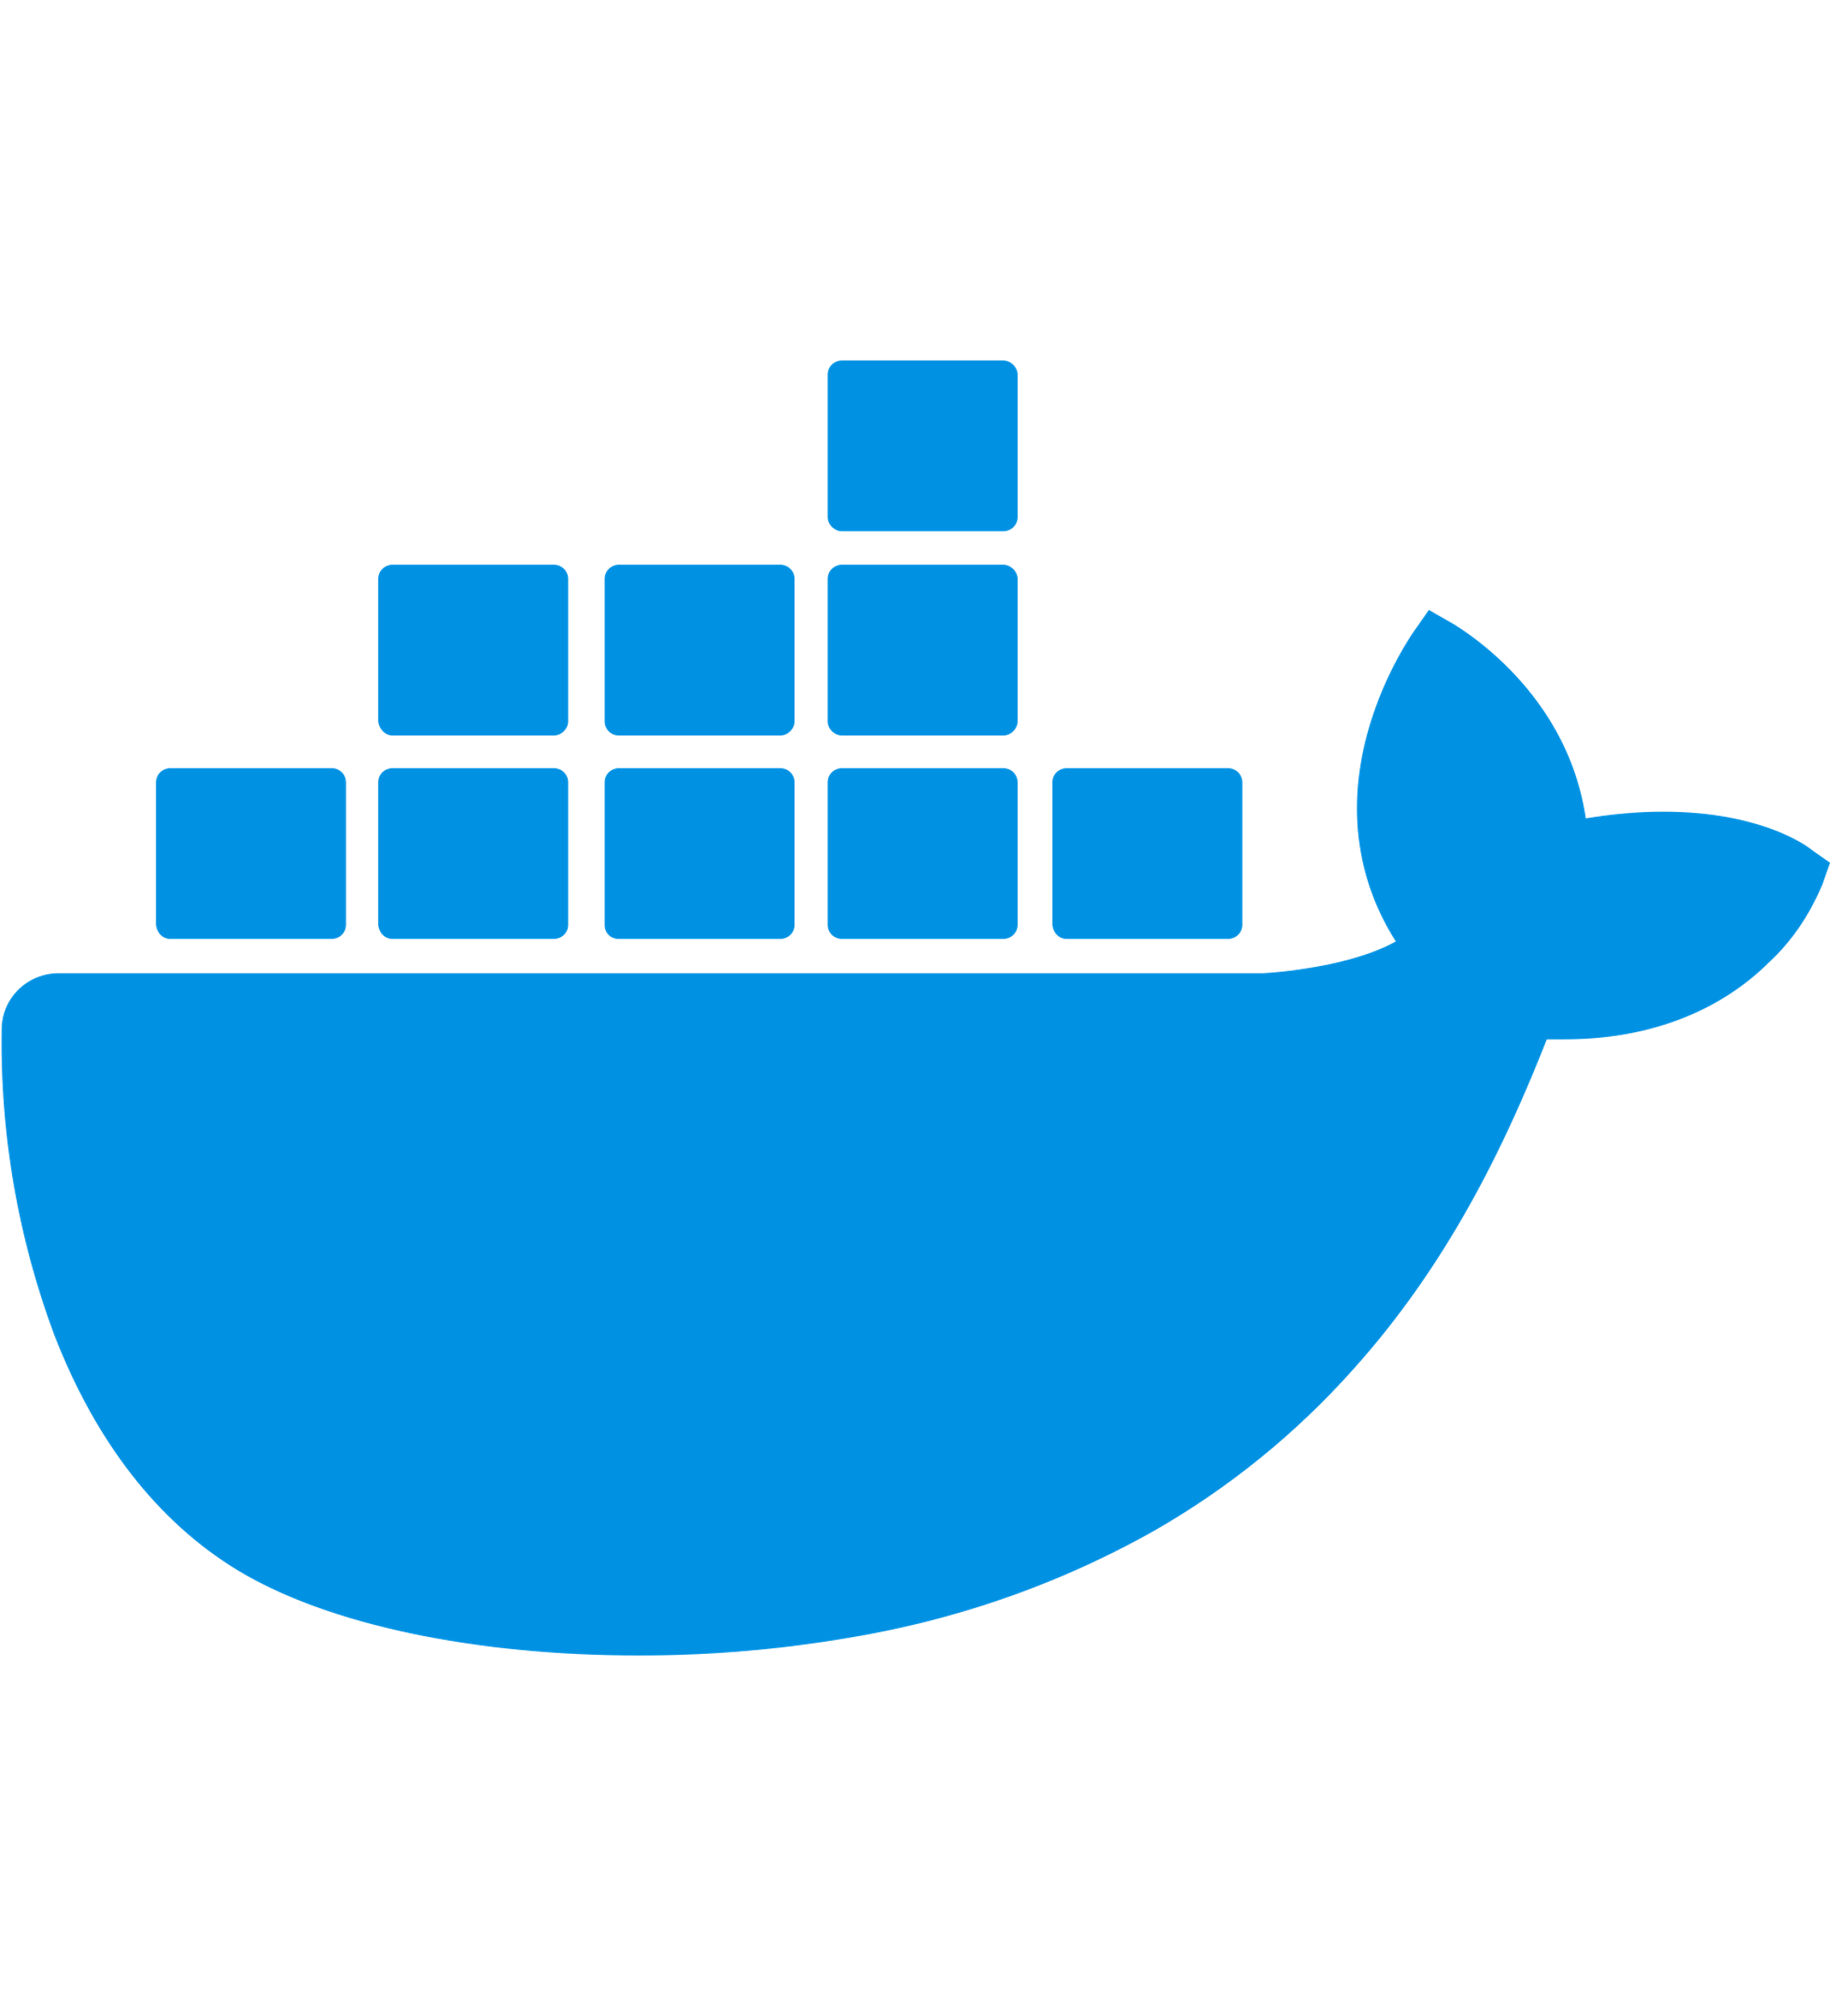





Overview
Data + Model
App
Data processing
Model hyperparameter tuning & output champion model to S3
+ the model from S3
Data scheduled pull
1 task on ECS
Notes:
Data processing: Split into 2012-2023, 2024 and 2025++ for train, test and deployment purposes
Note: All boxes are services

Slide 5

Architecture for param tuning on cloud
Define parameters on script
Param tuning on Github actions when pushing
Use Github actions with CML to create MD file for results
Retrain best model using same script
Upload best model to S3
Best model pulled from S3 when dockerising app

Slide 6
TODO
Pull ct to main. Just work on main from there
Automate both the CV and Final modelling on cloud (AWS Lambda, github actions, whatever). Importantly, give scores + iTry to merge with MLFlow if can, otherwise just do reporting separately. Important charts. Rmb to ensure S3 storing model has version tracking on
Ensure FastAPI app can read best model from S3:
https://devopscube.com/github-actions-oidc-aws/
Automate AWS Lambda updates (e.g. data cleaning) using AWS CLI/github actions so that don’t have to keep copy and pasting
Retraining champion model
Download new data filtered by date, process and then append to existing feature store (cannot be done, missing date of update)
Code robustness: Work on unit testing → Data + others. Robust tests. Practice one unit test per PR. Think about when to use try-except statements (get chatgpt to suggest). Perform checks while script is running as well, on top of the unit tests

Slide 7
Testing to do
Code
[D] Data processing code
[D] Data validity e.g. new values
App
Docker containers + their interaction – Integrated testing
[Skip] ML scripts
Nothing to test. All functions used are from some other package, or components of the script are so basic they don’t need to be unit tested.
General principle is that if script is reused and deployed, it should be tested. Furthermore, unit testing is even more required if it is a core component in a pipeline of automation. Hyperparameter tuning script sits on top of that pipeline, so it’s fine to skip
[Skip] Model
Prediction makes sense
Doesn’t seem to be done often, based on google

Slide 8
CT
T=M0
T=M-1
T=M
- Compare optimised models
- Compare old (on S3) and retrained model
Train-Validation
Test
A/B
Get best set of hyperparameters
Retraining based on time/data ingestion @ X time unit
Objective: Let model capture new trends in data, refresh model with same hyperparameters
Separate script which uses the same hyperparameters from experimentation (Github actions), but does the comparison and retraining on AWS Lambda
Train-validate
Implement A/B testing afterwards to check if there is indeed and improvement over the old model. Do not deploy if performance drops
Still necessary to compare 5 fold CV in addition to test set?
Pseudo-Canary testing?
Can find hard quality gates here: https://mlflow.org/docs/3.1.3/ml/evaluation/model-eval/

Slide 9
CI
Objective: Whenever want to update file on GitHub, to use a template for a sequence of events, which takes into account testing, and also reporting of the results of the push.
Makefile is the recipe, while the YAML file is the skeleton while pulls from the recipe + decides the environment variables which is fed into the recipe
Implemented for: Model prediction, app deployment, deploying AWS Lambda functions

Slide 10
Retraining
With new data pulled weekly on S3
AWS Lambda loads champion model from S3
Retrain challenger model based on train + test + retraining test
Threshold of 5% improvement
Push challenger to S3 if it wins
Data validation: Check for data drift on processed data
Numeric columns: Population Stability Index (PSI)
Categorical columns: Just check for new values

Slide 11
TODO
[D] 1 day: To implement CM as a layer above CT. If CM triggers something → then test for threshold in performance
Check for concept drift – Continuous monitoring: https://www.evidentlyai.com/ml-in-production/concept-drift
Compile concepts for model monitoring: https://www.reddit.com/r/mlops/comments/15z3bfo/model_performance_in_production/
[D] 2 days: Complete testing + How to test and deploy streamlit + fastAPI more robustly
There is no way to perform interaction test of dockerised streamlit + fastAPI at the moment, have to do it manually.
[D] Fix communication of docker containers on AWS ECS
How to link data validation lambda to retraining lambda?
2 days: Change hyperparameter tuning to include
Config.py to define parameters for different models
Hyperparameter tuning script to load config.py and test all models at once
Hyperparam mode: to output json file of best hyperparams and model
Output final mode: Github actions workflow to change argument of script to output best model, using cli. To seek approval on Github before uploading best model to S3
1 day: CT: Think a bit more about the business point of view, metrics to use, wrt importance of AB testing and also pros and cons of retraining often
Logging

Slide 12
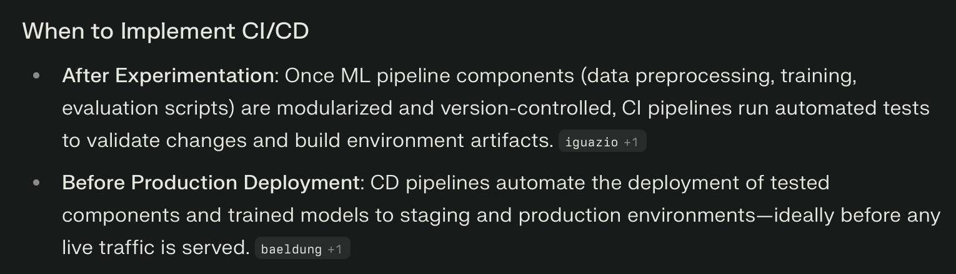

Slide 13
Logging
Logging (if have time). Get chatGPT to suggest. Used with AWS cloudwatch, but watch the costs involved. http://logging.apache.org/log4j/1.2/manual.html

Slide 14
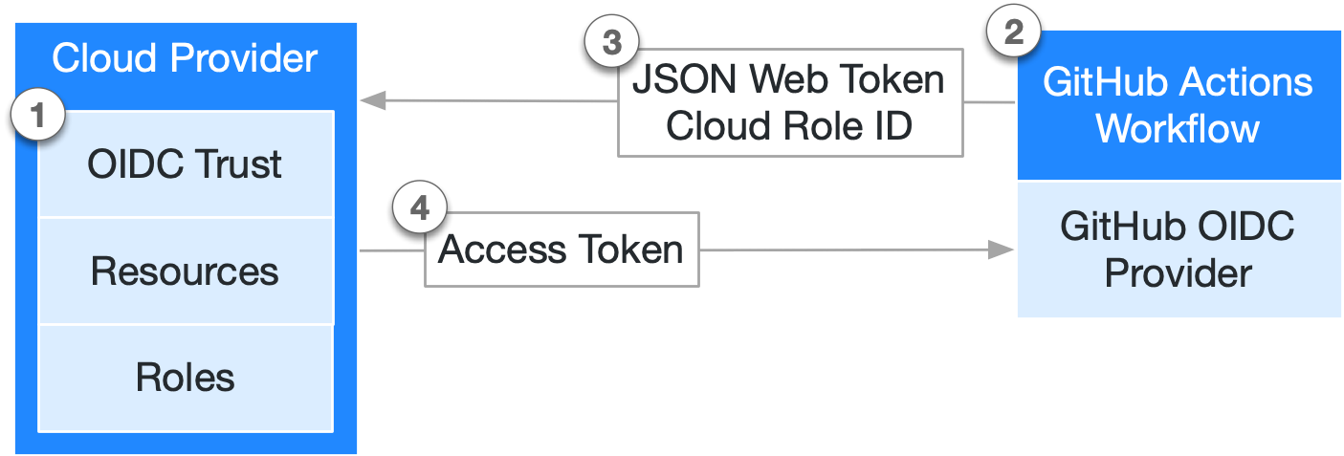
Github OIDC
Github action accesses service using the Github role assumed
With role given which already trusts OIDC in a federated way
AWS Service (needs to be able to assume role)

